Slide 1
A Study Concerning Employee Reviews for Google, Amazon, Apple, Facebook, Microsoft, and Netflix
Echo Liu, Yuefu Wu, Mo Yang, Li Su

Slide 2
Project
Overview
Part 1: Problem Description
Part 2: Methodology
2.1 Data Preprocessing
2.2 Exploratory Data Analysis
Text Mining
Trend Analysis
2.3 Predictive Modeling
Part 3: Conclusion

Slide 3
Part 1: Problem Description
What are the similarities and differences from these companies based on employee reviews?
Which company stands out the most from various aspects and is worth working for?
What are the aspects that firms need to improve?

Slide 4
Dataset Description
Dataset
Topic: Google, Amazon and more employee reviews
Companies: Amazon, Apple, Facebook, Google, Microsoft, Netflix
Quantity of employee reviews: over 67k
Source: Web-scraped from Glassdoor
Variables:
Character: company name, location, position, summary, pros, cons, advice to management
Numeric: overall rating, work-balance rating, career opportunities rating, culture values rating, senior management rating, comp & benefits ratings
Total: 15 variables

Slide 5
Part 2: Methodology
Separate tables according to companies
Top 10 words to describe a company
Data formatting: transform date type
Models to predict rating
Deal with missing values
Split attribute: job.title into two columns
Sentimental analysis
Trend analysis: a.current vs. former employee
B.rating over years

Slide 6
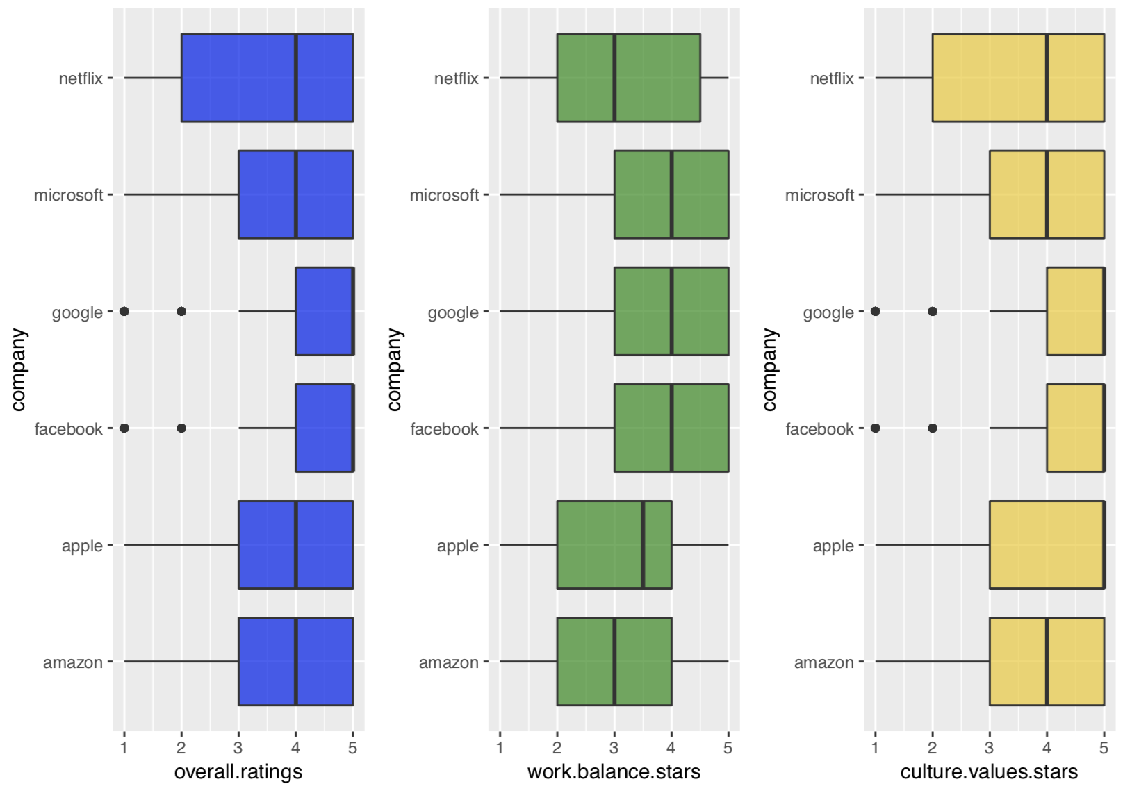
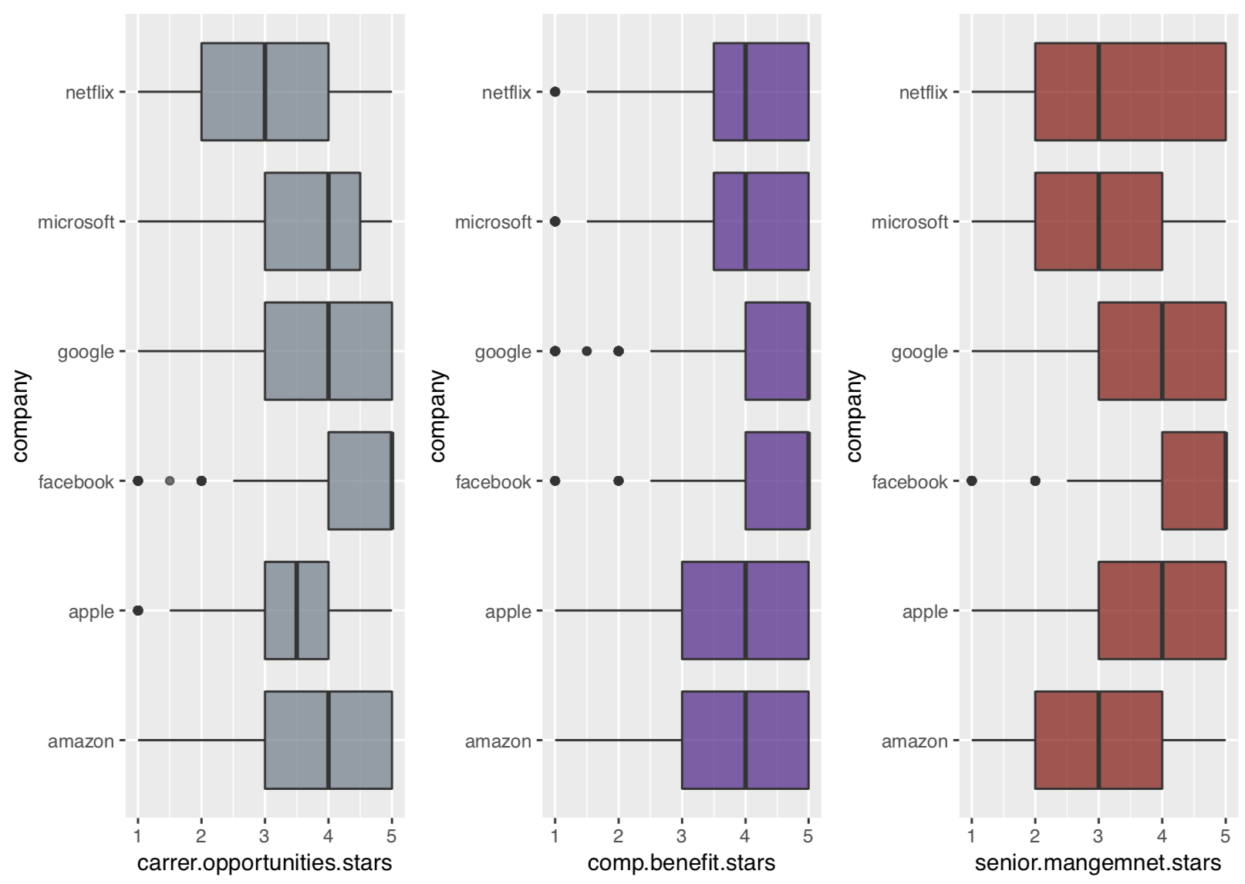
PART 2.2 EDA: ratings
Compare employees’ opinions on 6 aspects by each company: overall ratings / work-life-balance/ culture values/ career opportunities/ company benefits/ senior management

Slide 7
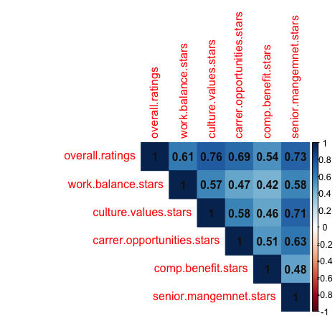
Correlation

Slide 8
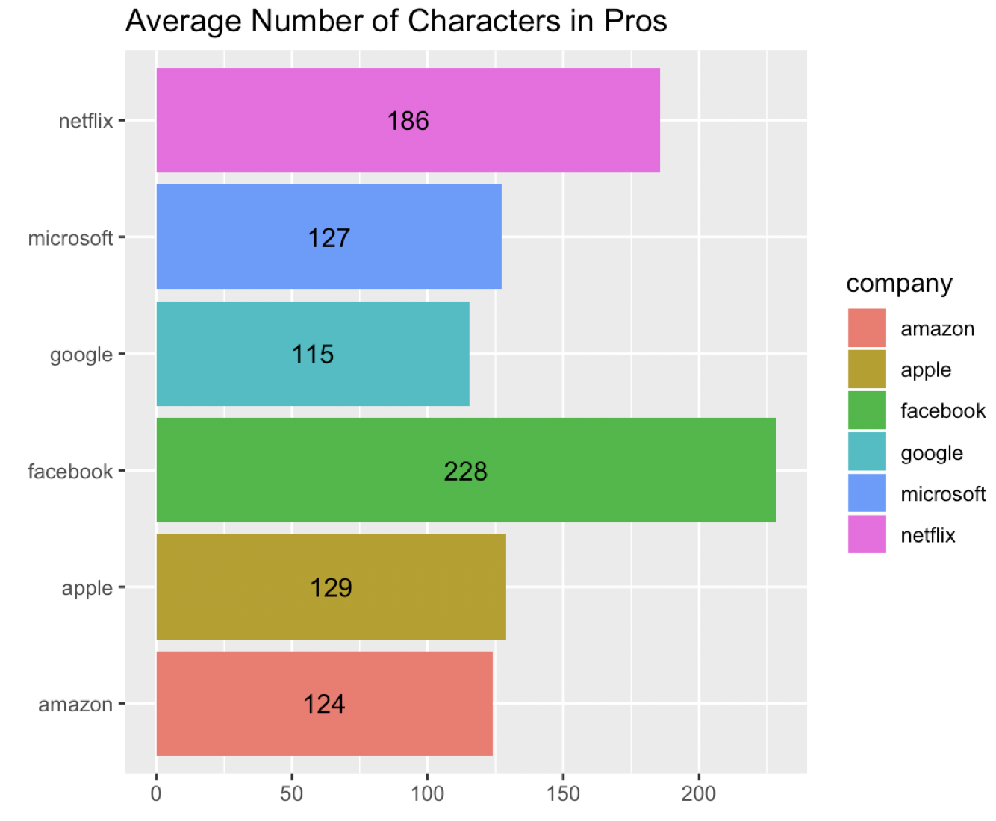
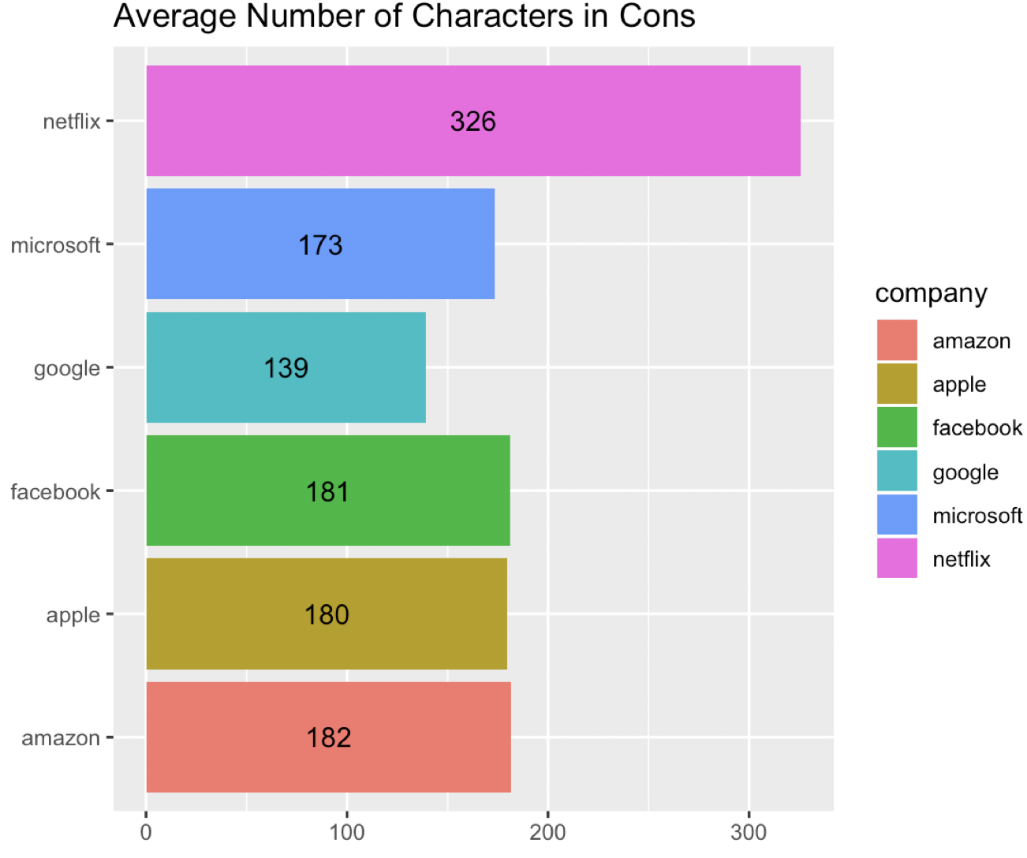
Part 2: EDA- Text Mining
2.1 Character count comparison
Highest number of pros count:
Facebook
Highest number of cons: Netflix

Slide 9
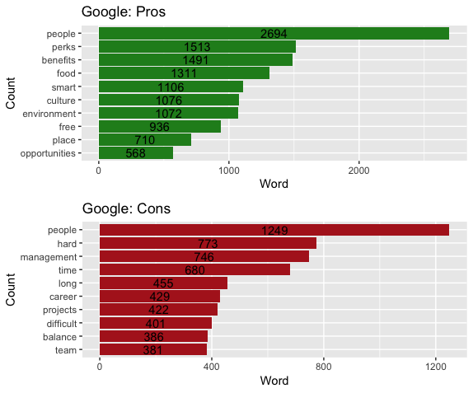
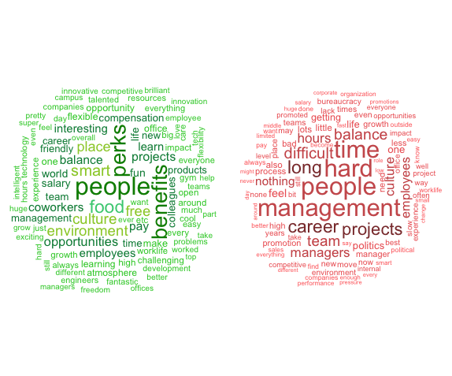
Part 2: EDA-Text Mining :
2.2 Frequent Words Counts: Google

Slide 10
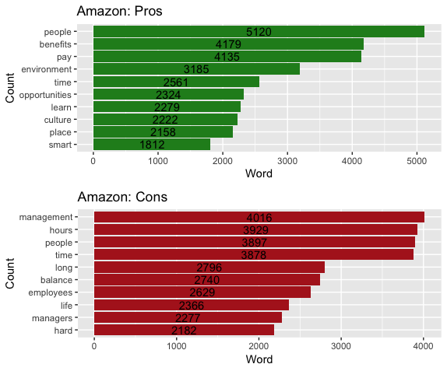
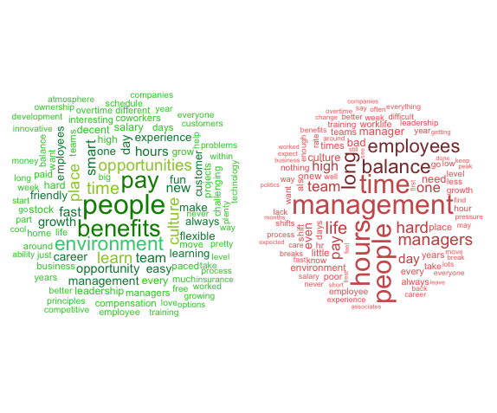
Part 2: EDA-Text Mining :
2.2 Frequent Words Counts: Amazon

Slide 11
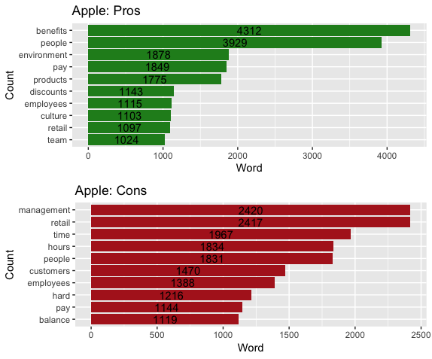
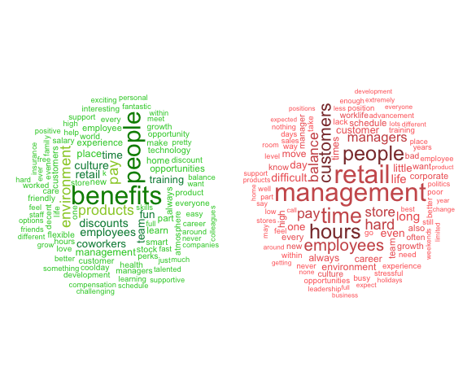
Part 2: EDA-Text Mining :
2.2 Frequent Words Counts: Apple

Slide 12
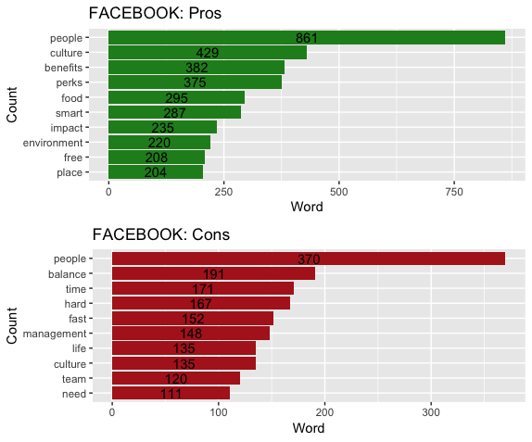
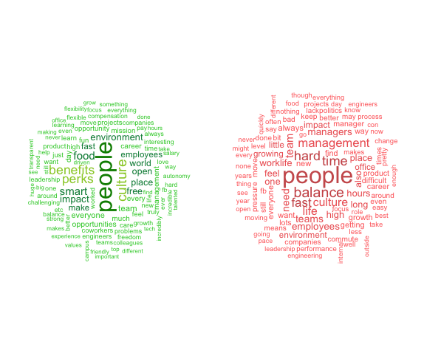
Part 2: EDA-Text Mining :
2.2 Frequent Words Counts: FACEBOOK

Slide 13
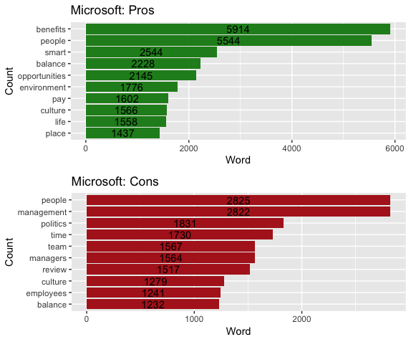
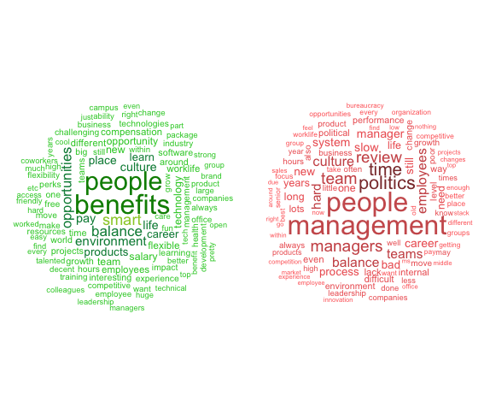
Part 2: EDA-Text Mining :
2.2 Frequent Words Counts: Microsoft

Slide 14
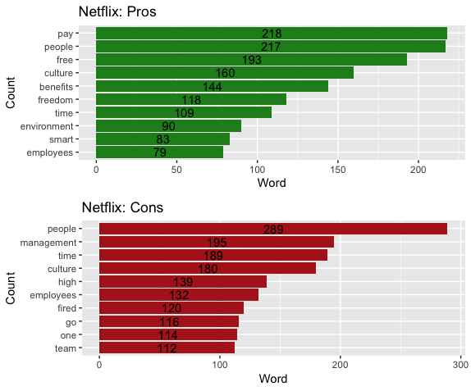
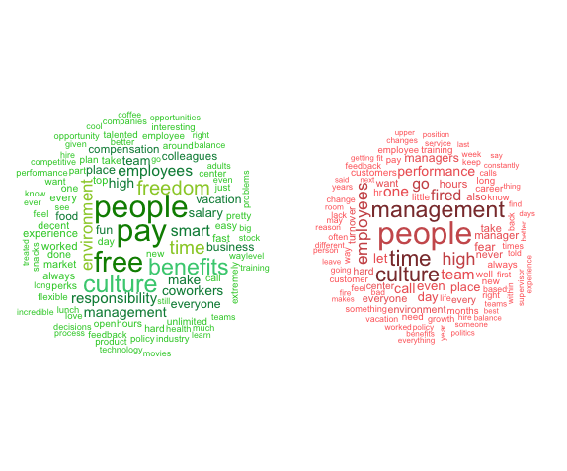
Part 2: EDA-Text Mining :
2.2 Frequent Words Counts: Netflix

Slide 15
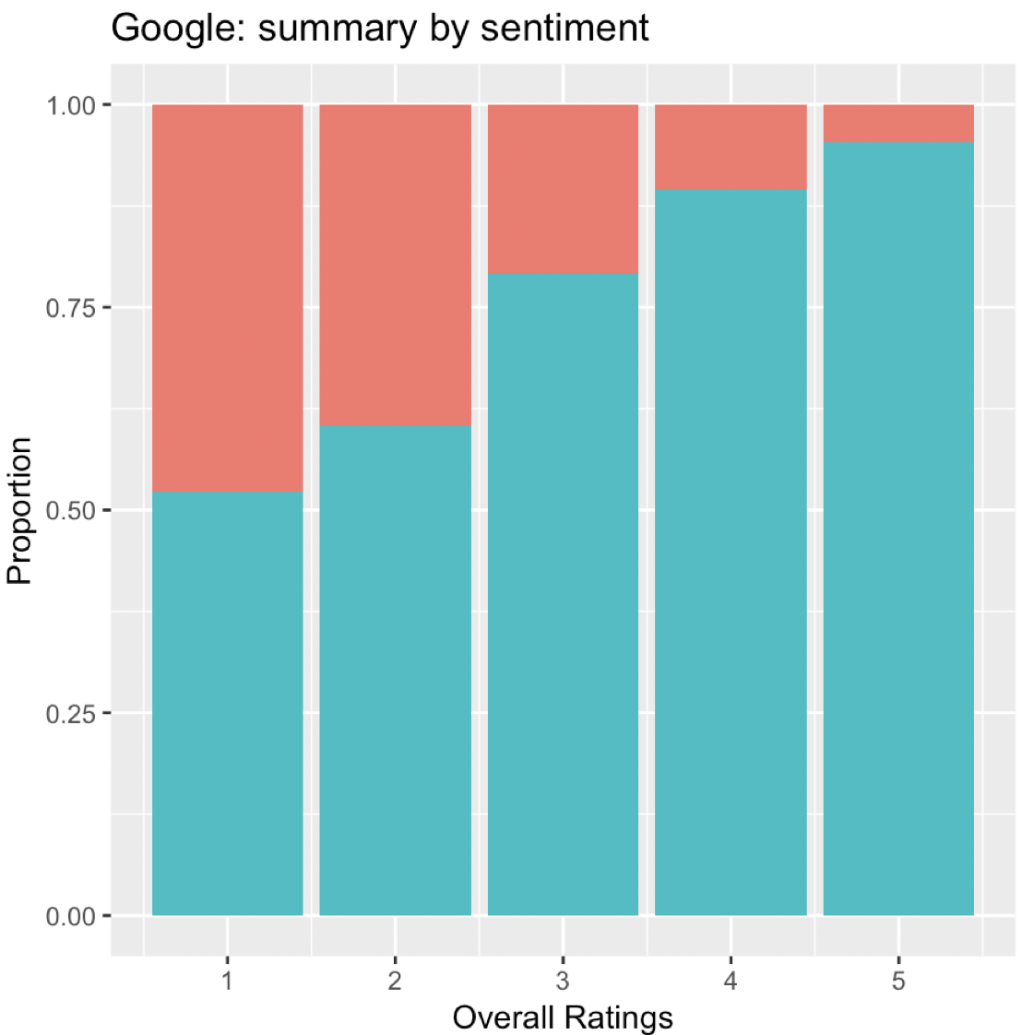
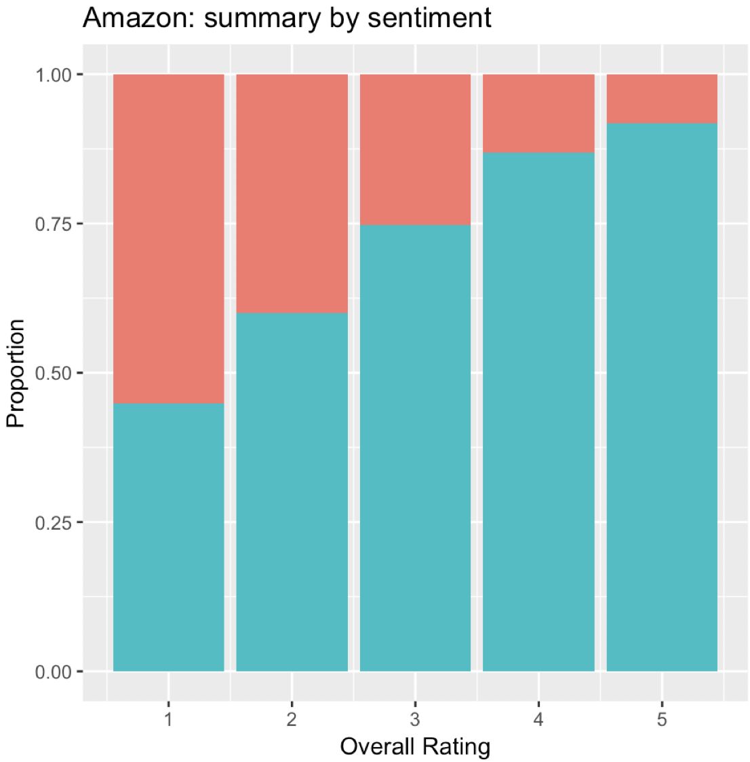
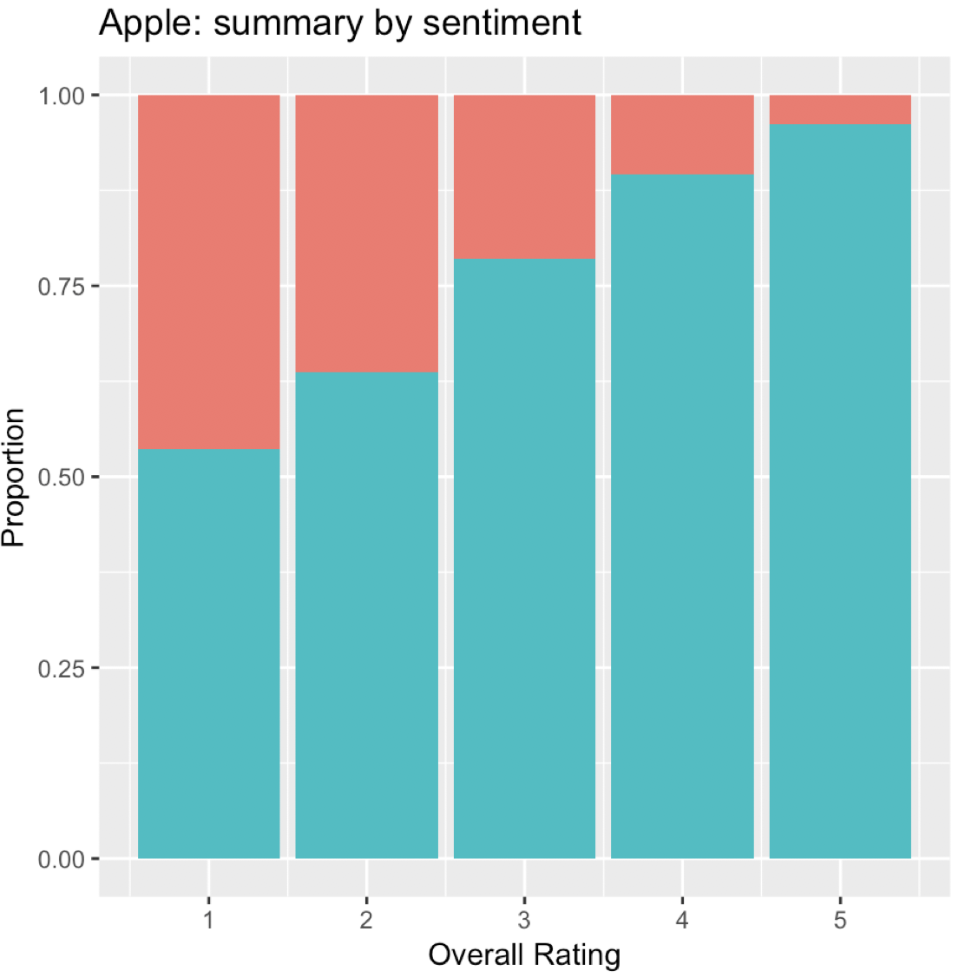
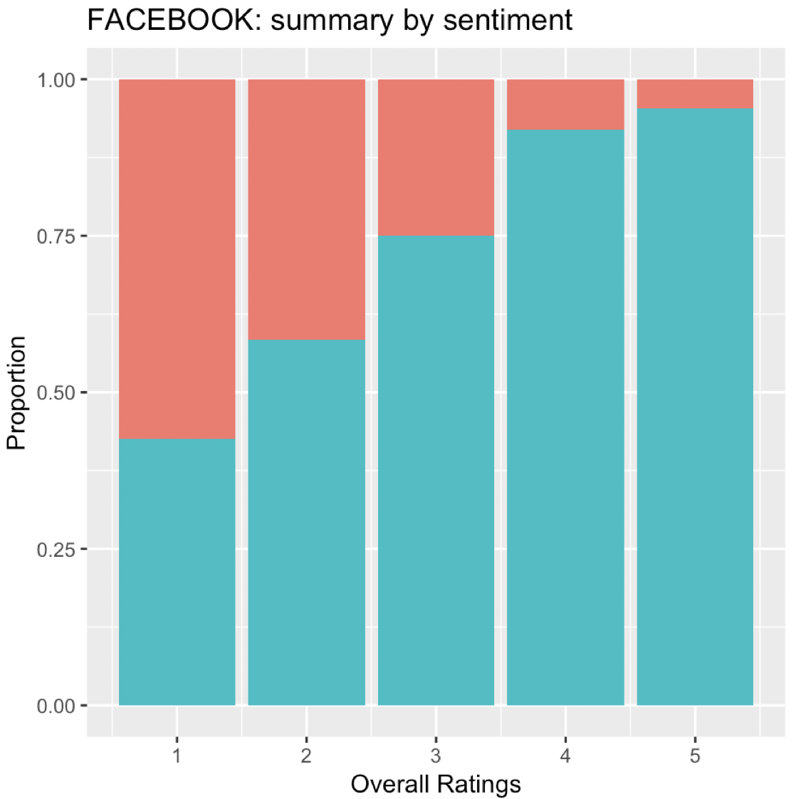
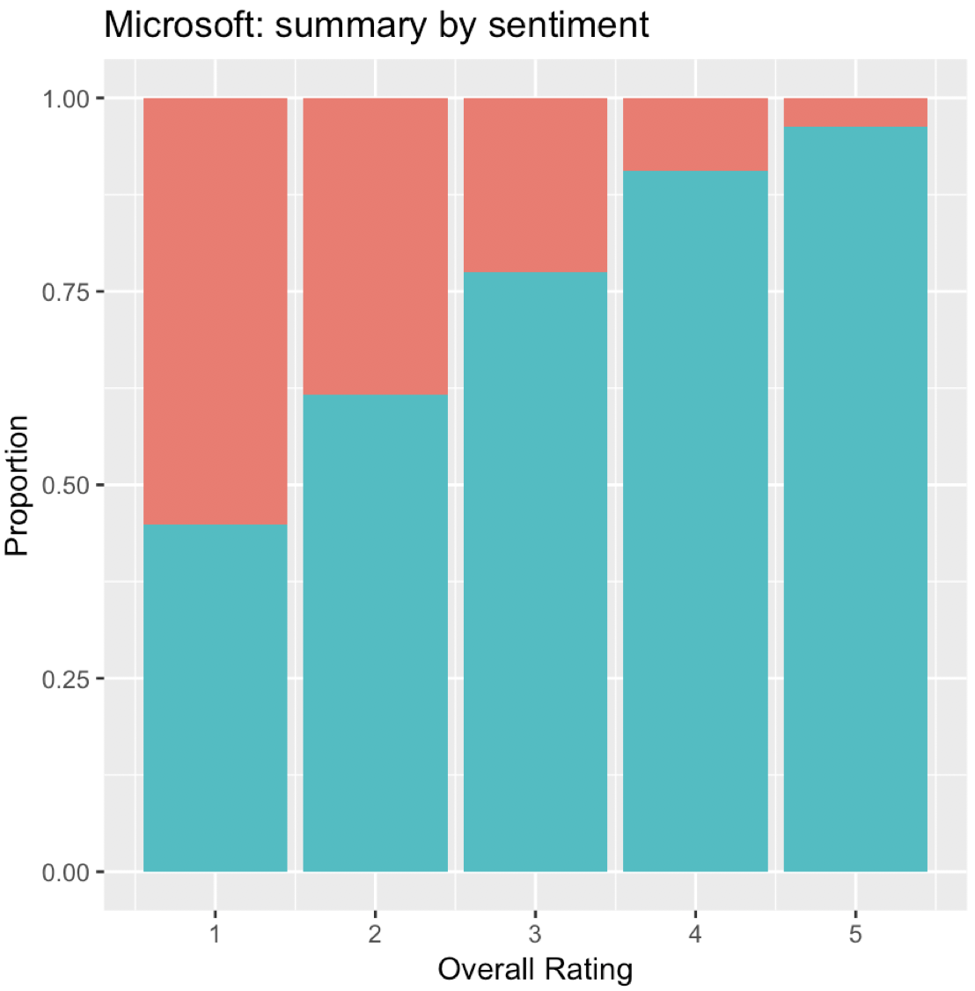

Part 2: EDA-Text Mining :
2.3 Sentimental Analysis
What is the relationship between positive/negative words in summary and overall ratings?
Visualization of the proportion of positive/negative words in summary
Proportion of positive words is correlated with overall rating
Quantify this correlation: 0.441

Slide 16
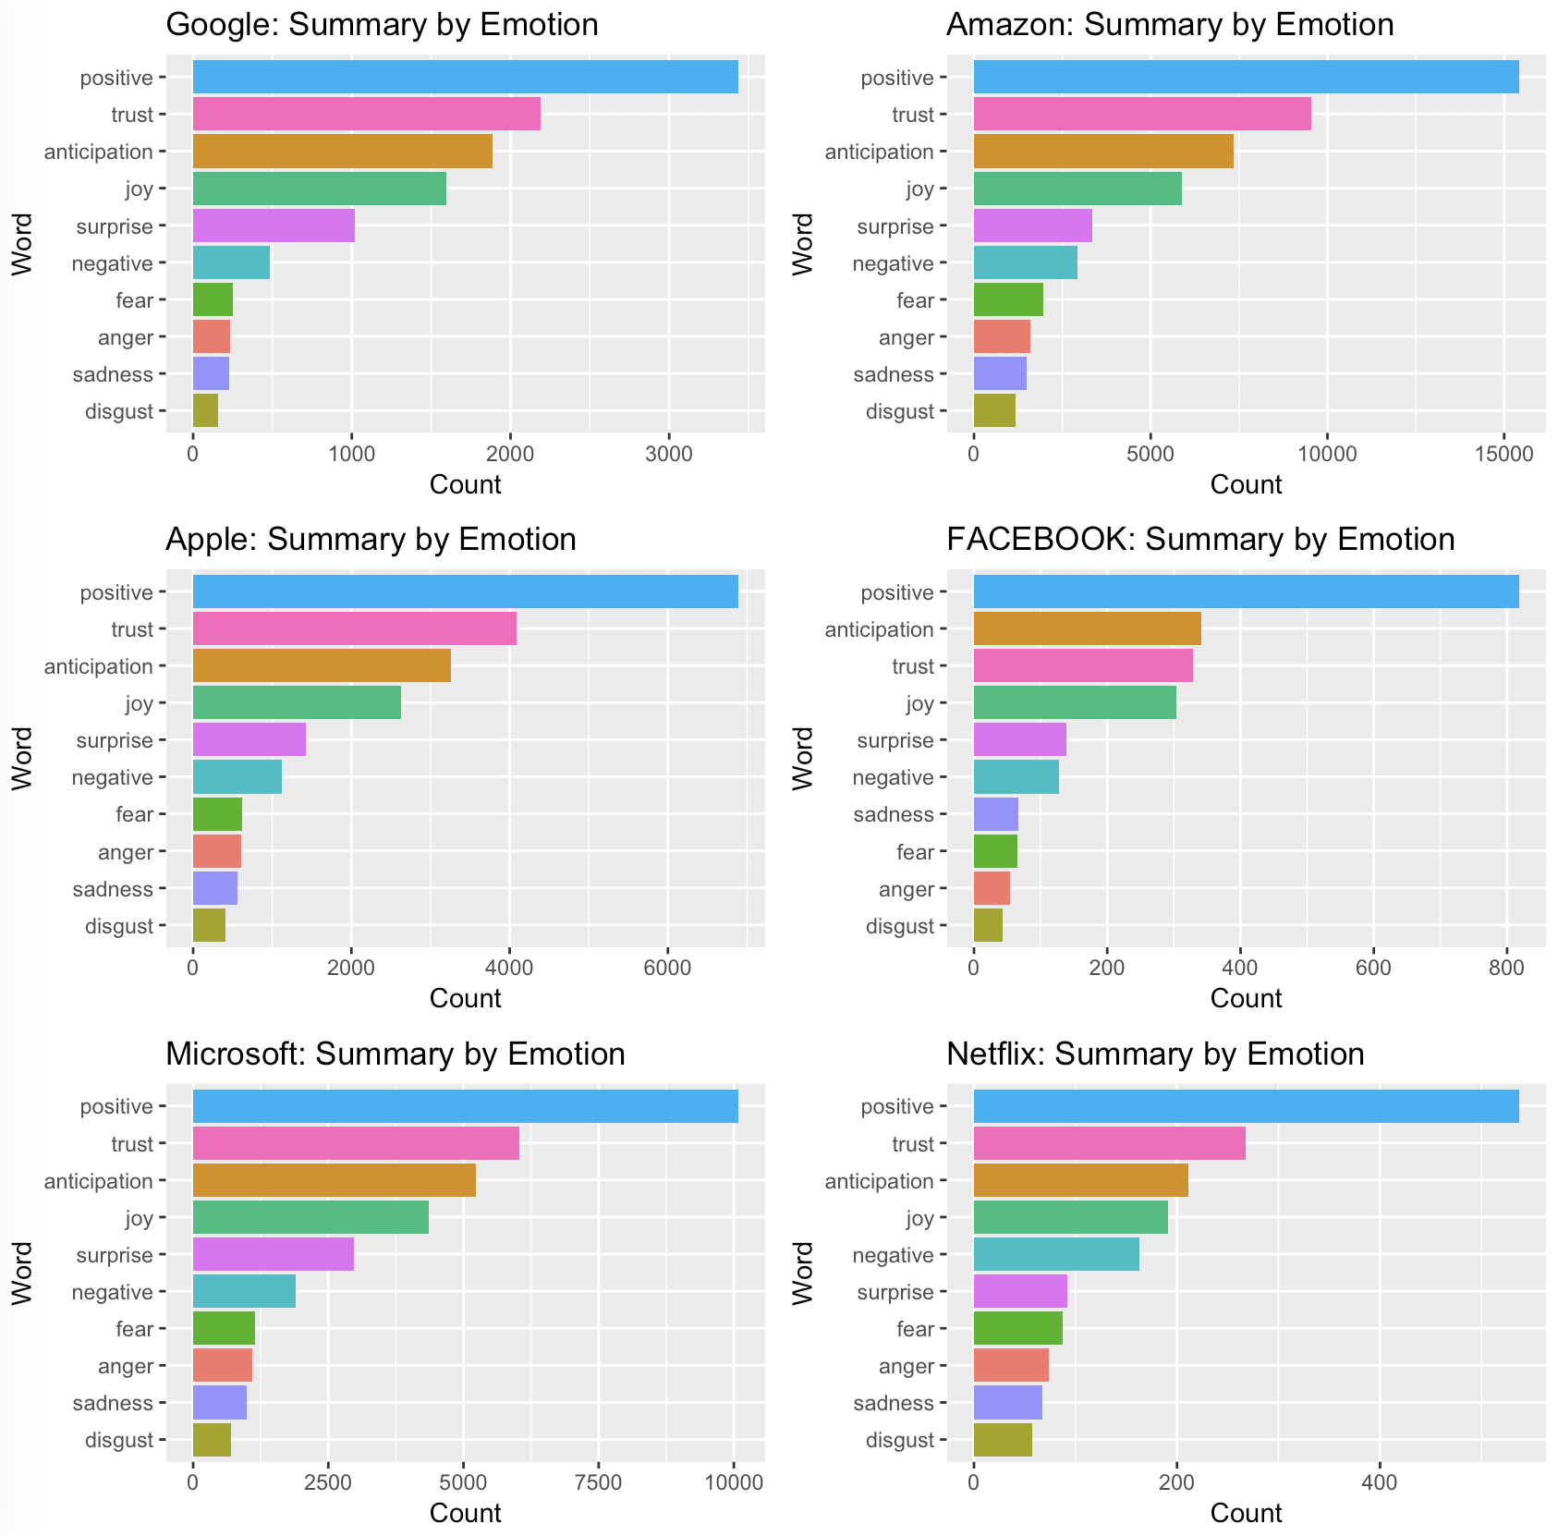
Part 2: EDA-Text Mining :
2.3 Sentimental Analysis: by employee’s emotion
Positive emotion words appear most frequently for each company
Netflix has highest negative emotion words such as fear, anger, sadness and disgust

Slide 17
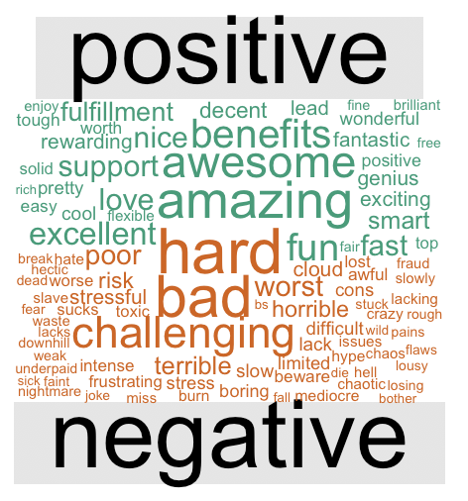
Part 2: EDA-Text Mining : Summary
What do an employee like and dislike about a company in general?

Slide 18
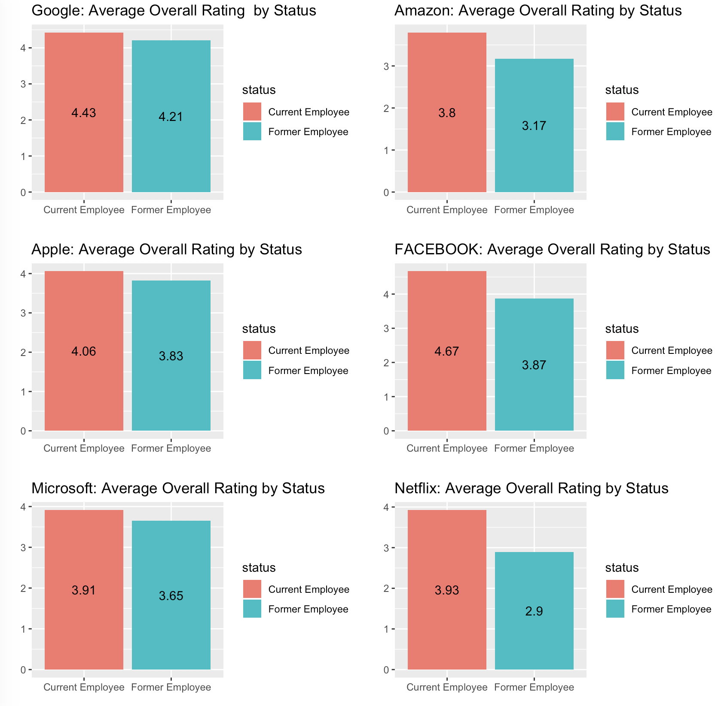
Part 2: EDA - Trend Analysis
2.4 Do current employees review the companies higher than former ones?
Current employees rated their firms higher than former employee
Google has the most satisfied current employee
Netflix has the biggest gap for company rating between current and former employee

Slide 19
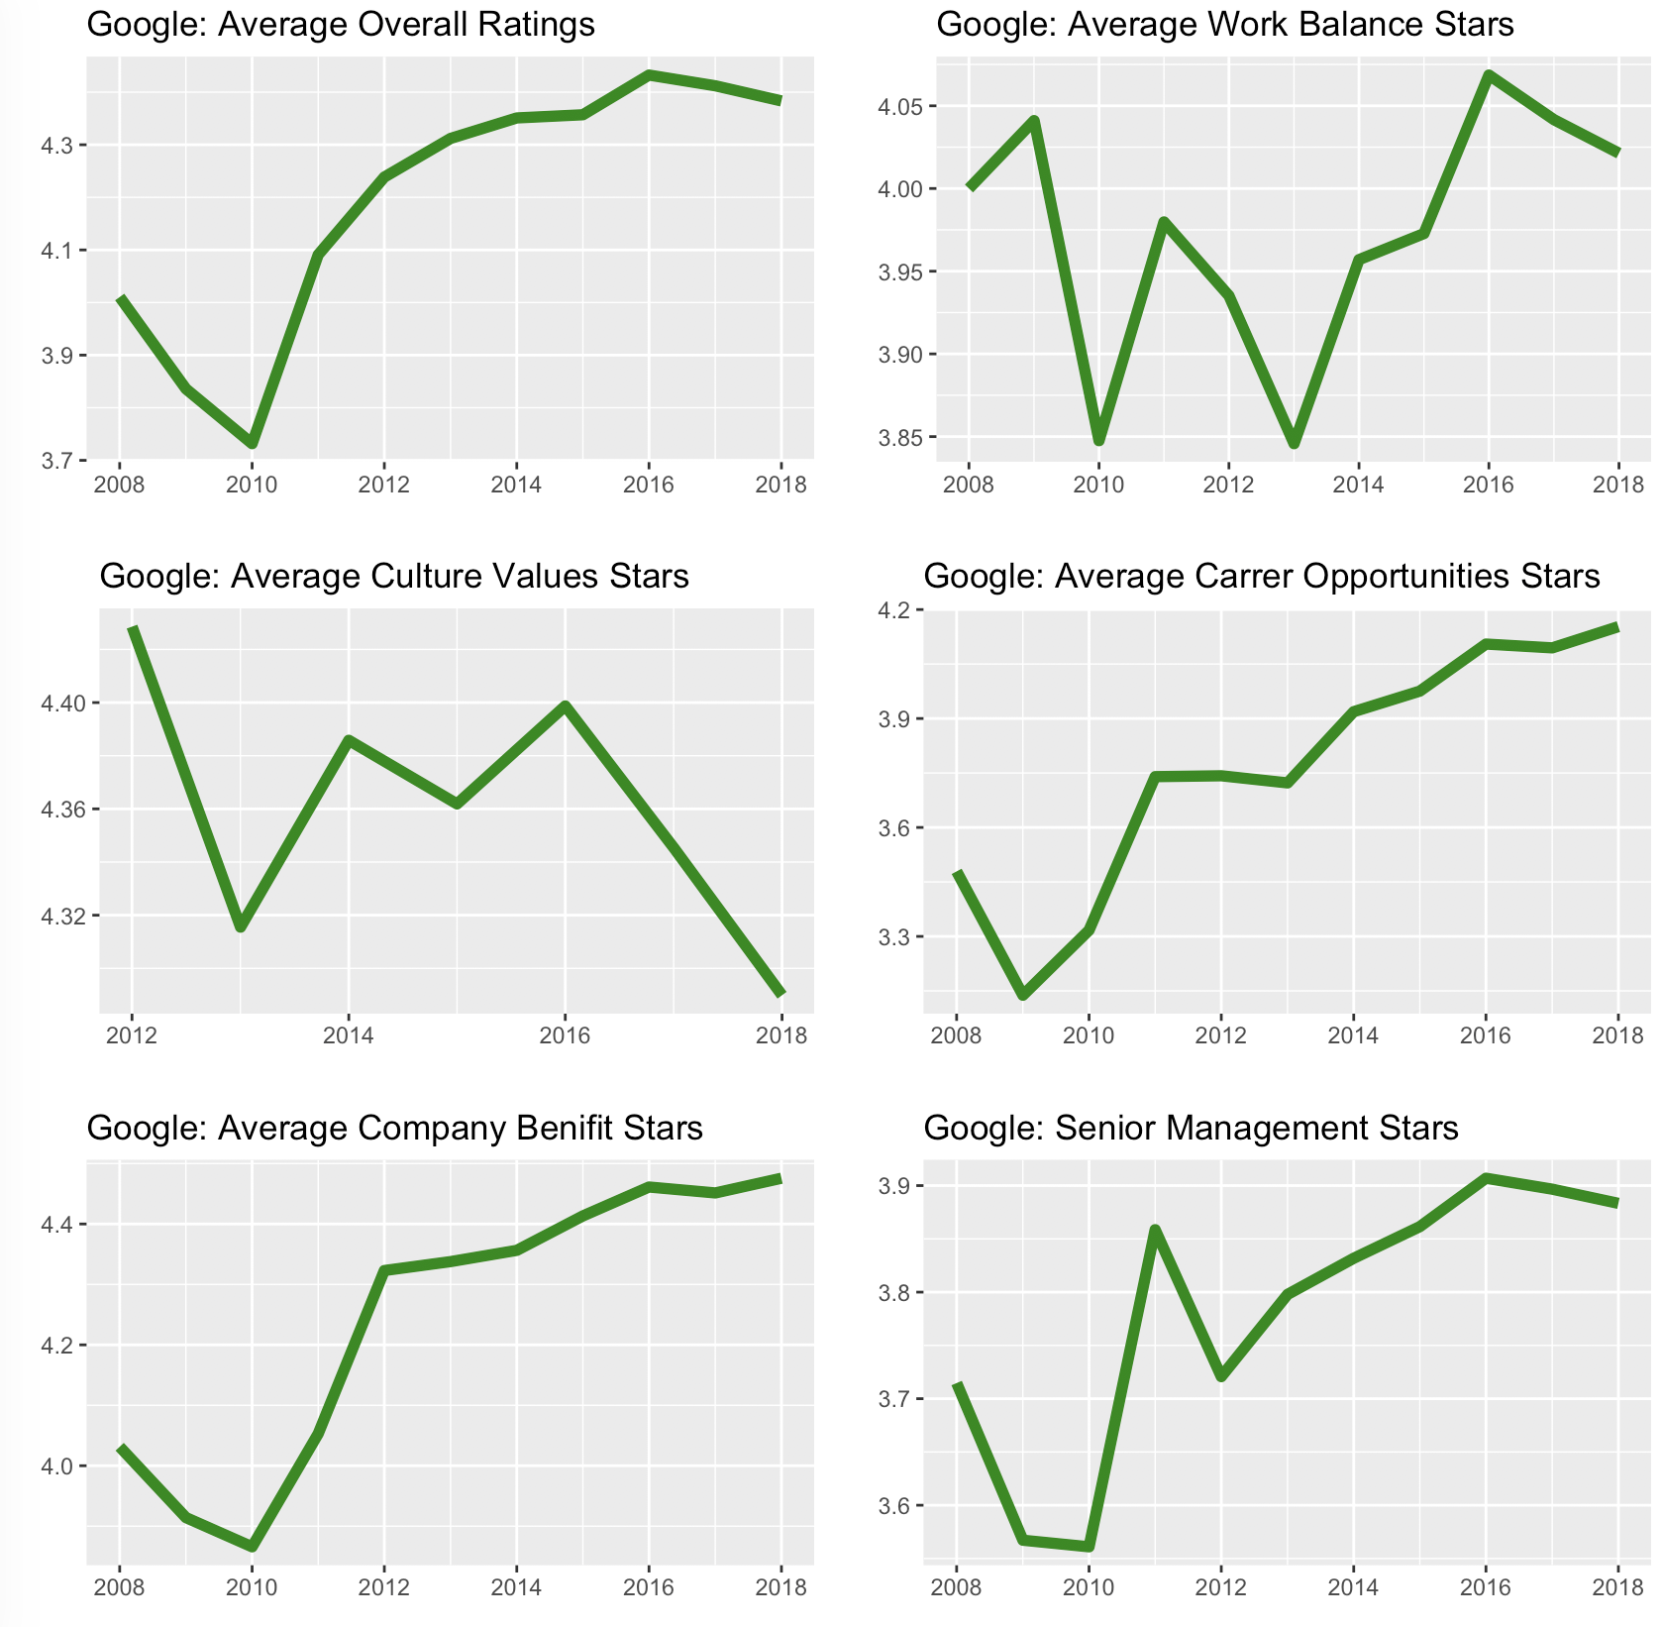
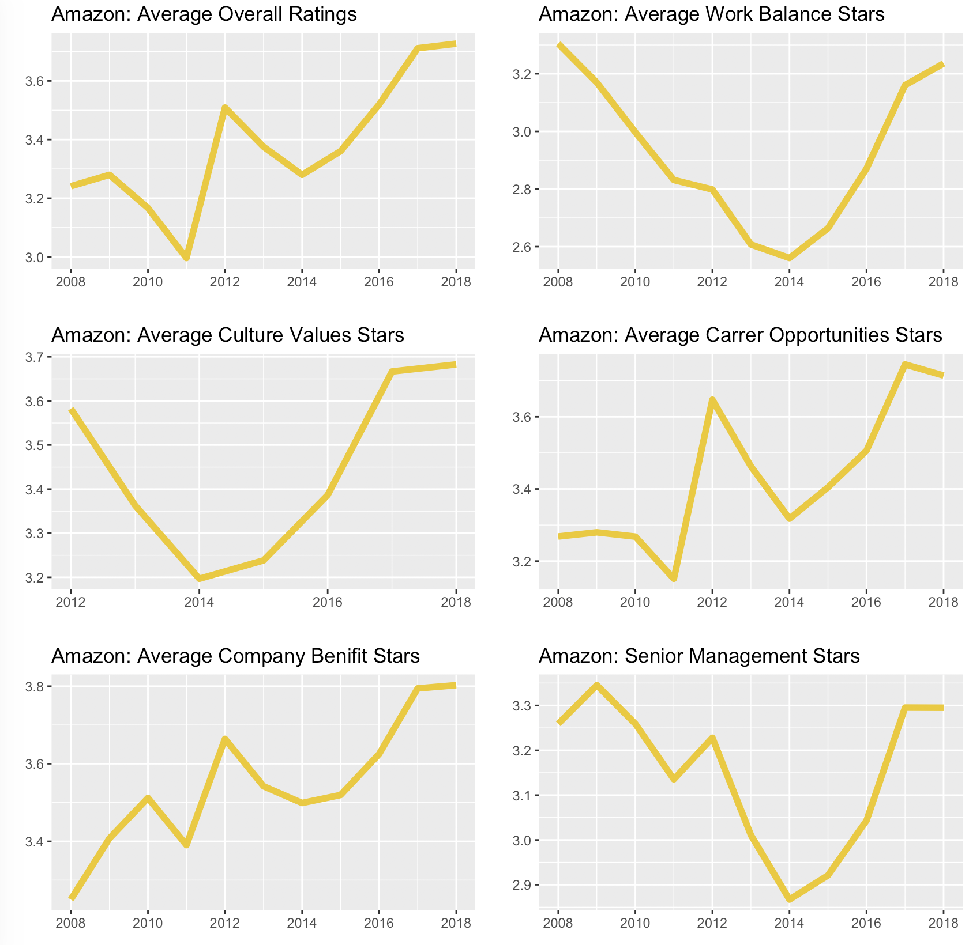
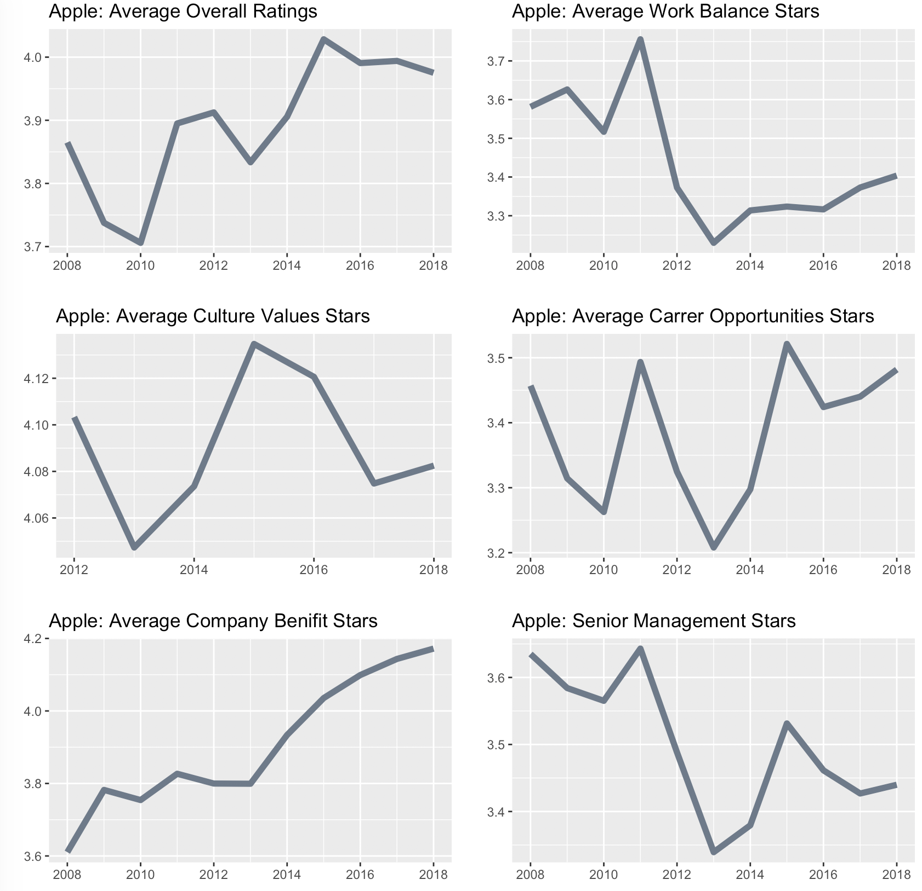
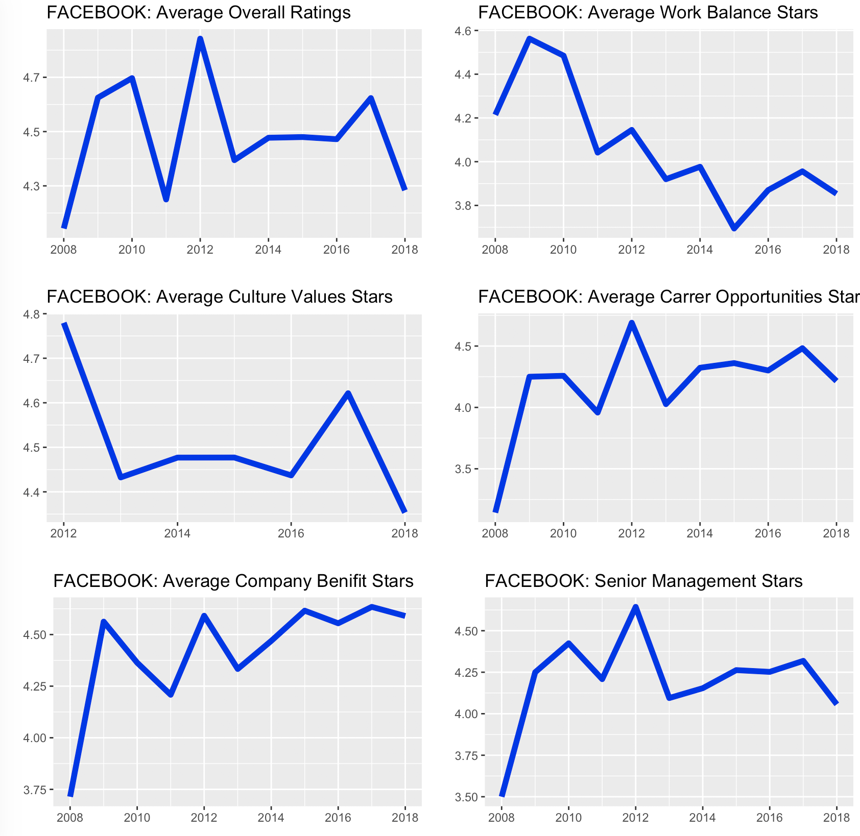
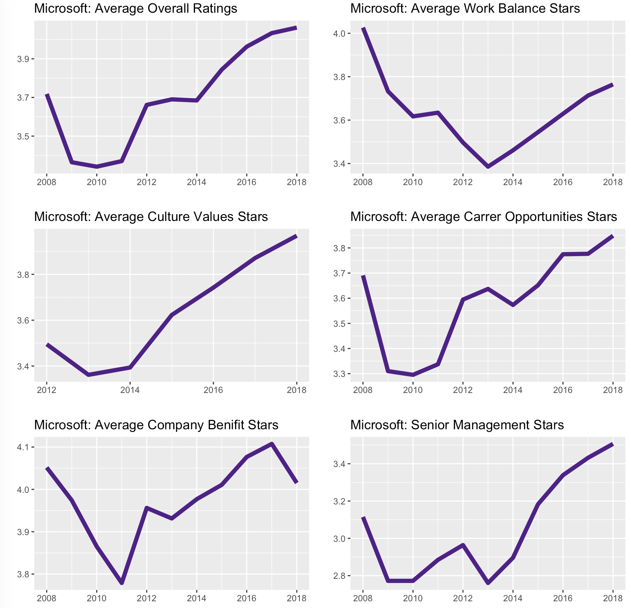
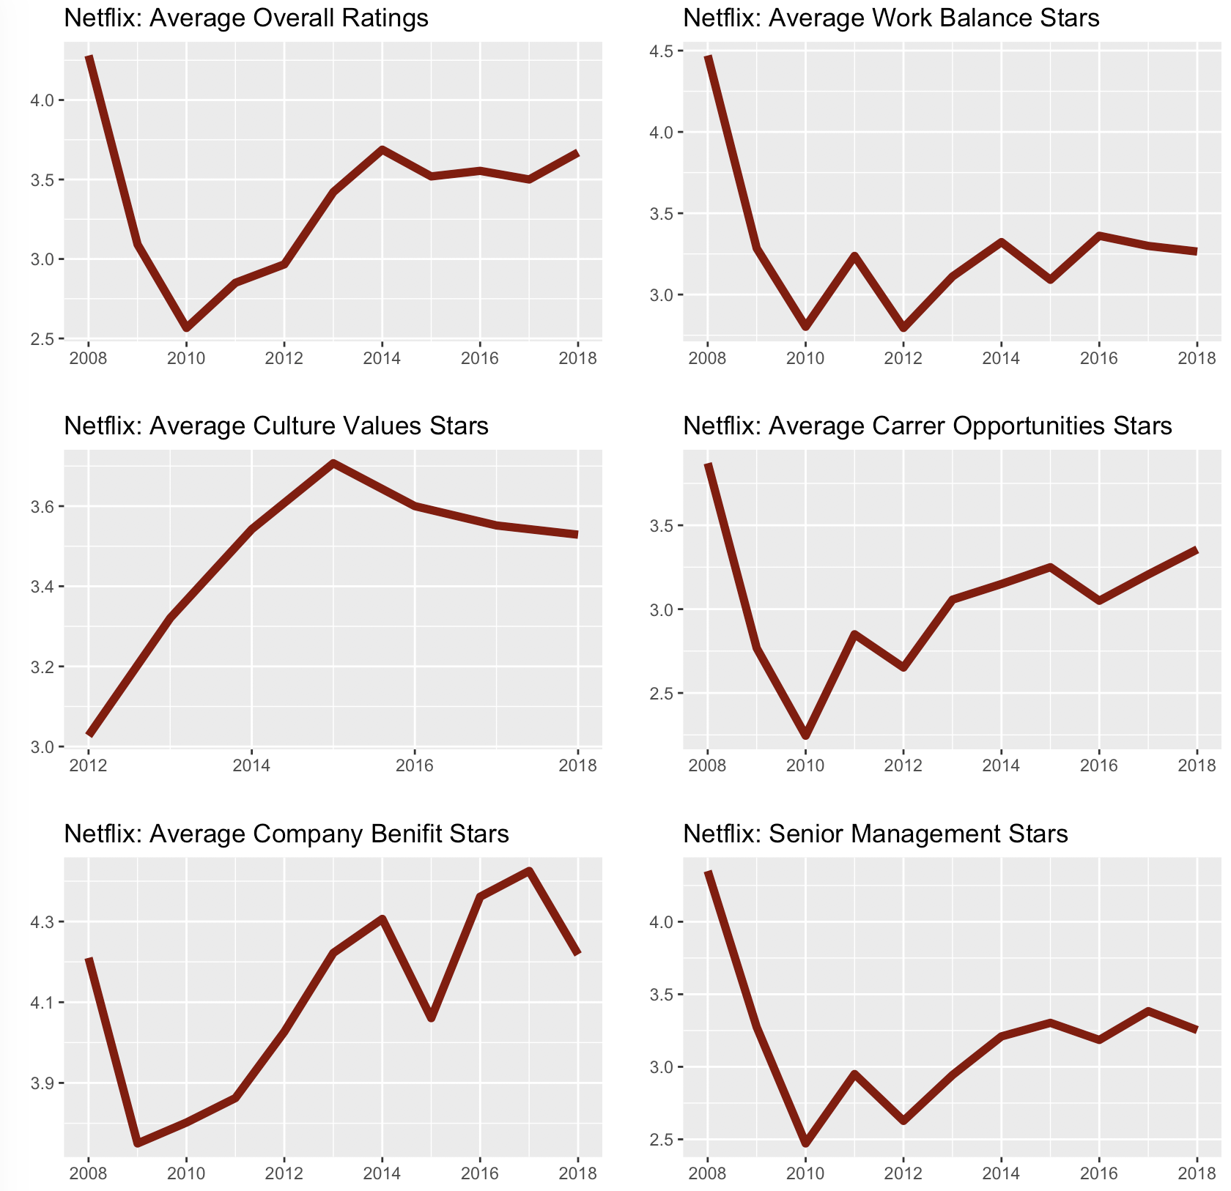
Part 2: EDA - Trend Analysis
2.5 How did the ratings change over years for each company?
Google: the trends of all variables were on stable except for culture values stars.
Microsoft’s company benefit stars have decreased over the decade with great fluctuation
Apple, Facebook and Netflix all share very fluctuant trend over years
Netflix performs the poorest especially in overall ratings and senior management stars

Slide 20
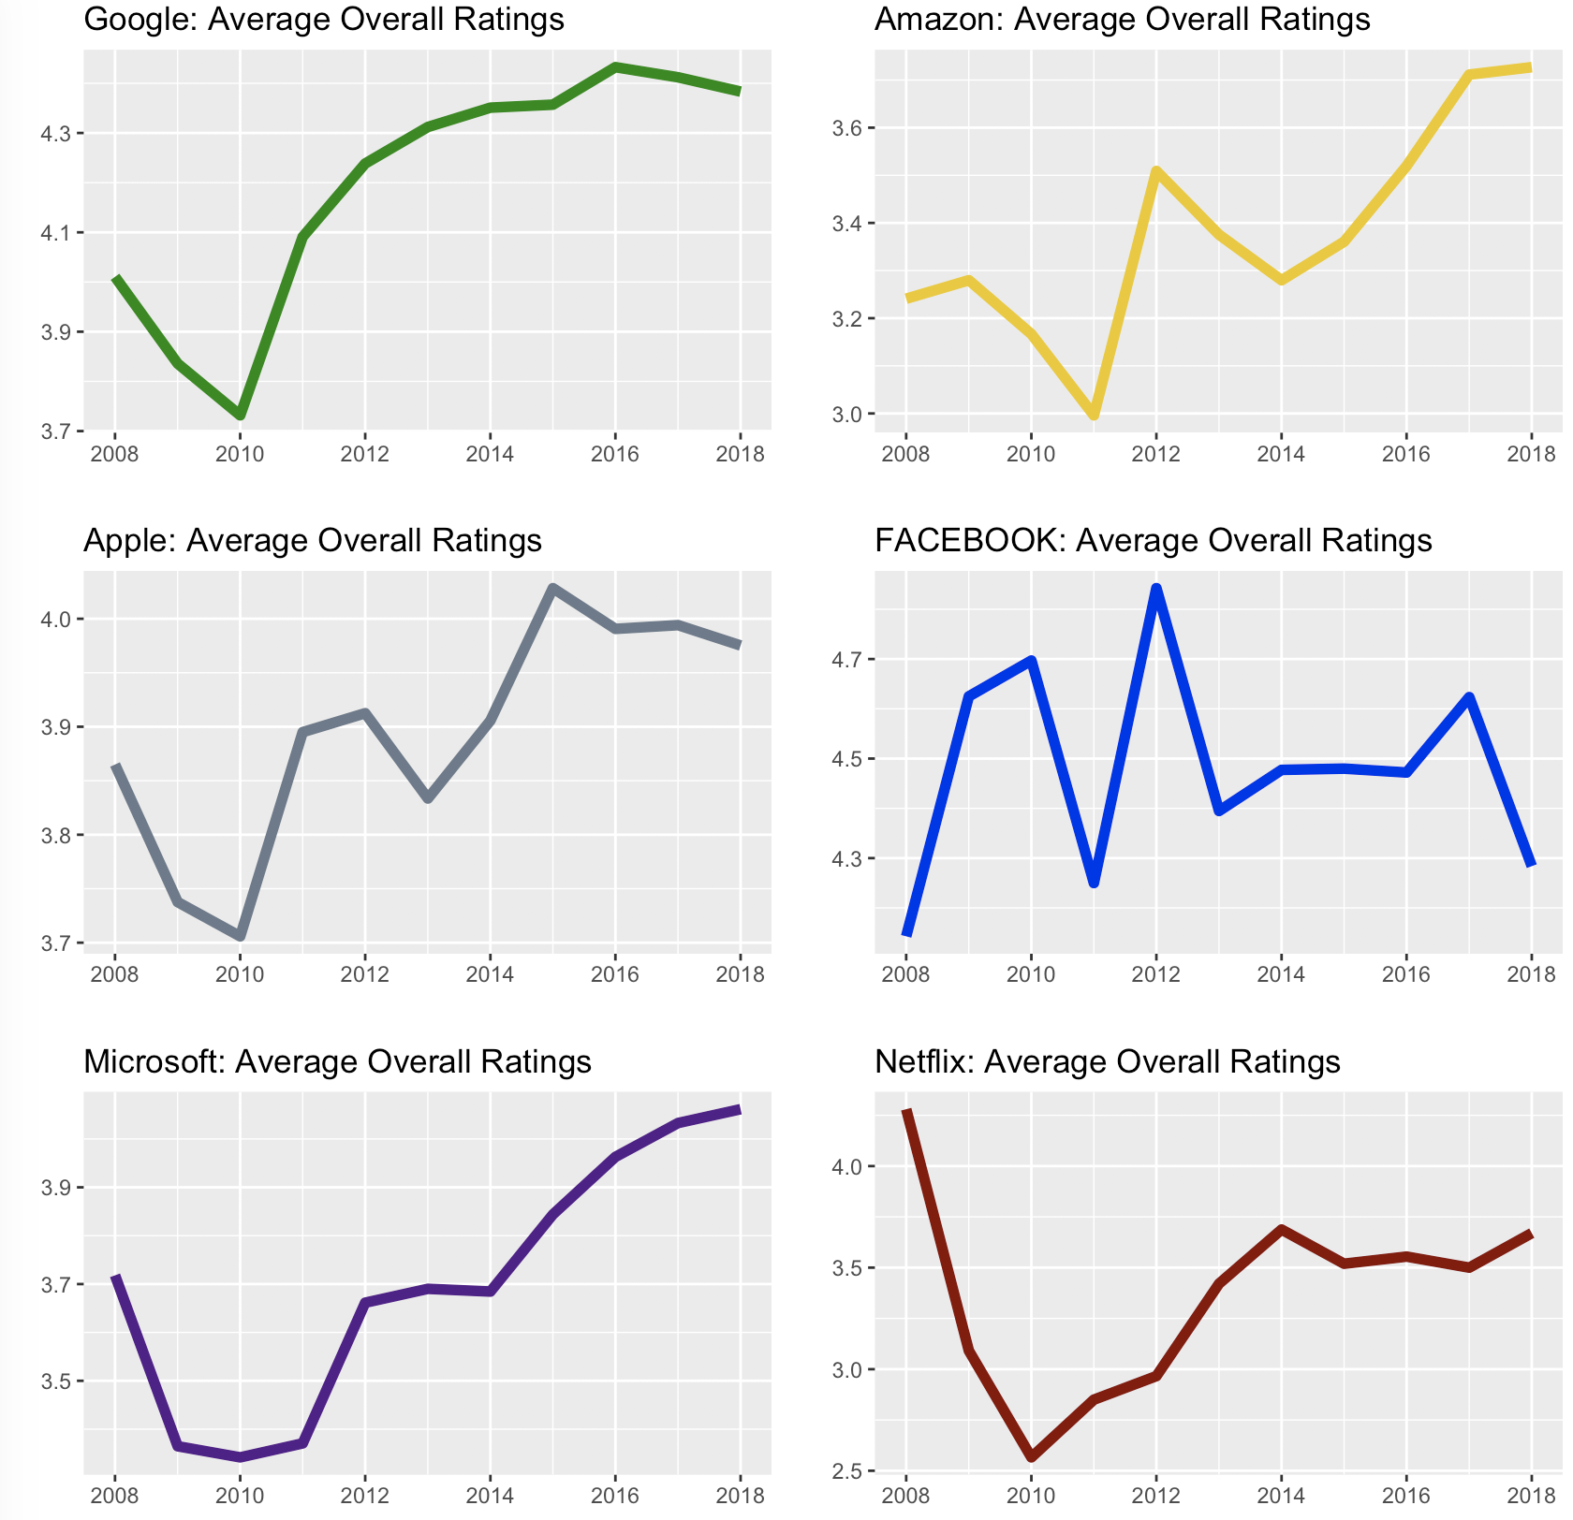
Trend in Overall Rating
These firms are making an improvement to raise the satisfaction of employees. Specifically, Google, Amazon, Apple, and Microsoft are making stronger effort comparing to Facebook and Netflix.

Slide 21
Part 2: Model Summary
We use predictive analysis (decision tree and linear regression) to predict the overall ratings of companies based on the summary comments of the employees.
Help companies and job seekers to better evaluate the overall situation of the company.
Achieve RMSE around 1,1~1.2

Slide 22






Part 3: Conclusion
Findings on employees’ reviews:
Facebook and Netflix - longest descriptions in Pros
Netflix - longest descriptions in Cons
Apple & Amazon - working environment
Netflix -potential higher payment
Microsoft & Google intelligent employees
Amazon & Microsoft - better career opportunities
Management is an overall problem
Netflix - the fire problem
Microsoft - workplace politics

Slide 23
Business Recommendations:
For the six companies:
Facebook, Netflix, Microsoft, and Google - improve working environments
All companies - management system
Netflix - reduce working pressure and improve their employees’ work-life balance.
For job seekers:
To gain a clear understanding of the culture, value, benefits, and environment
To find the most appropriate company to fulfill personal goals
Tips: How to choose the company
Environment-oriented companies: Apple and Amazon
Higher payment company: Netflix
More career opportunities: Microsoft
Educational environment: Google & Microsoft

Slide 24
Thanks!

